Slide 1
Developing a Blockchain-Based eVault for Legal Records
PIP4004 University Project
Review-1
Batch Number: CSE_CST_17
Under the Supervision of,
Prof. Shaik Salma Begum
School of Computer Science and Engineering
Presidency University
Roll Number | Student Name
20211CST0006 | Nagaruru Sunandhan
20211CST0039 | Bobbiti Yaswanth Reddy
20211CST0041 | Kruthika S
Name of the Program: BTech
Name of the HoD: Dr. Saira Banu
Name of the Program Project Coordinator: Dr. H M Manjula
Name of the School Project Coordinators: Dr. Abdul Khadar A

Slide 2
Introduction
Traditional legal record systems face issues like data tampering, unauthorized access, and slow retrieval processes.
These challenges affect judicial efficiency and reduce trust in legal institutions.
This project proposes a blockchain-based e-Vault to provide secure, tamper-proof, and transparent document management.
It uses smart contracts for automated access control and audit logging, ensuring only authorized access.
A hybrid design with blockchain and off-chain storage ensures both data integrity and system scalability.

Slide 3
Literature Review
NyaYa: Blockchain-based Electronic Law Record Management Scheme for Judicial Investigations Pronaya Bhattacharya, Deepti Saraswat, Sudeep Tanwar (2021).
Blockchain Technology for Secure and Transparent Legal Record Management Satoshi Nakamoto (2008).
Smart Contracts for Access Control and Permissions in Blockchain Systems Vitalik Buterin (2014).
User-Friendly Interfaces for Blockchain Applications Mougayar W (2016).
Interoperability of Blockchain Systems with Existing Databases Cachin C & Vukolic M (2017).
Recordism: A Social-Scientific Prospect of Blockchain from Social, Legal, Financial, and Technological Perspectives Zihao Li, Hao Xu, Yang Fang, Boyuan Zhao, Lei Zhang (2022).

Slide 4
Existing method Drawback
Centralized databases are prone to breaches and insider threats.
No tamper-proof audit trails.
Manual permission management is inefficient.
Lack of integration with legal infrastructure.
Non-compliance with modern privacy regulations.

Slide 5
Proposed Method
The system uses a permissioned blockchain to record document metadata and cryptographic hashes, ensuring tamper-proof tracking.
Smart contracts are implemented to automate access control, allowing only authorized users to perform actions based on their roles.
Actual legal documents are encrypted and stored off-chain in a distributed file system like IPFS to maintain scalability and privacy.
Users interact with the system through a web-based interface that supports uploading, retrieving, and sharing of documents securely.
Integration with existing legal systems is enabled through APIs, allowing seamless communication with court databases and case management tools.

Slide 6
Objectives
Secure and tamper-proof document storage.
Transparent audit trails.
Granular access control using smart contracts.
Interoperability with legacy systems.
High scalability and regulatory compliance.
Promote user adoption through intuitive interfaces.

Slide 7
Methodology/Modules
User Management Module: Manages user registration, login, and role assignment.
Frontend Interface Module: Enables users to upload, retrieve, and share documents.
Backend/API Module: Connects frontend with blockchain and storage, handling user requests.
Blockchain Module: Stores metadata, manages permissions, and logs actions immutably.
Off-Chain Storage: Holds encrypted documents outside the blockchain.
Encryption Module: Secures documents through encryption and decryption.
Integration Module: Connects with external legal systems and databases.
Audit & Logging Module: Records all user actions for transparency.

Slide 8
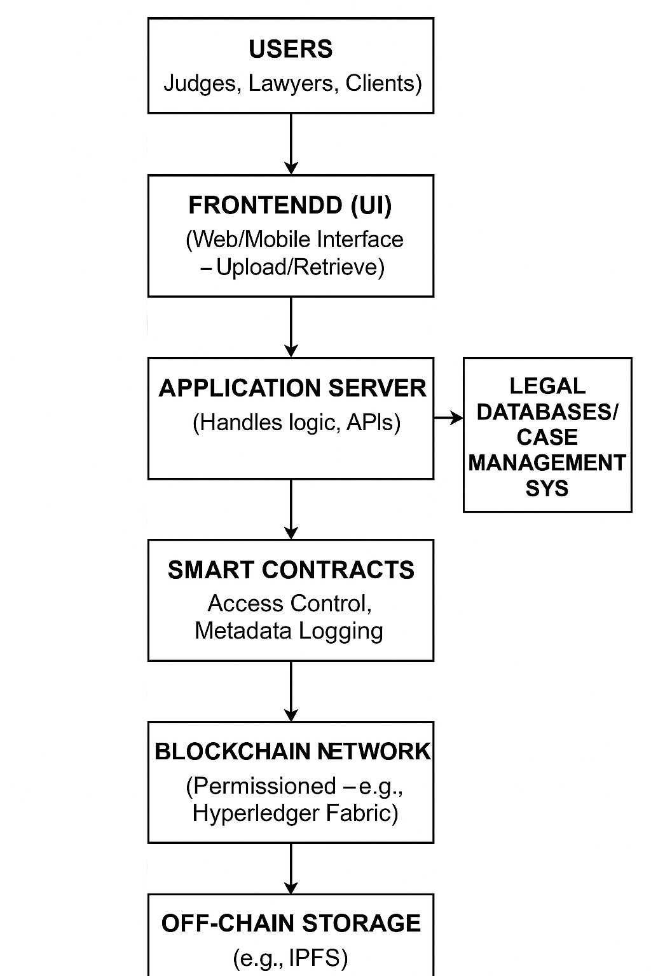
Architecture

Slide 9
Hardware/software components
Hardware:
Minimum: 2 vCPU, 4GB RAM per node
IPFS nodes & Fabric validator nodes hosted on cloud (e.g., AWS)
Software:
Blockchain: Hyperledger Fabric
Language: Go, Node.js
Frontend: ReactJS
Storage: IPFS
Encryption: AES-256
Tools: Truffle, Ganache, VS Code

Slide 10
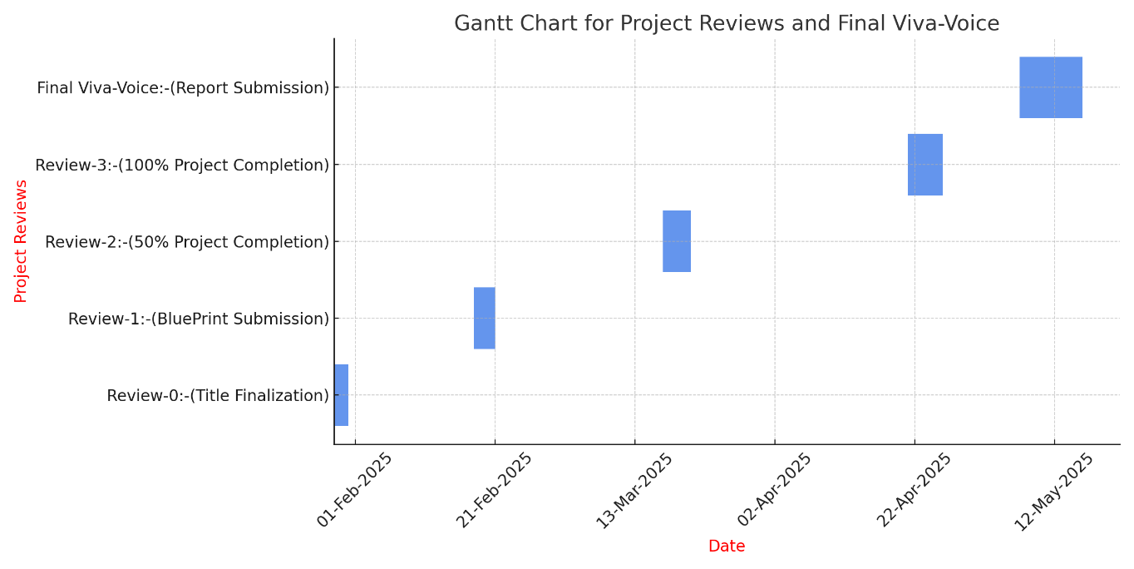
Timeline of Project

Slide 11
Expected Outcomes
Immutable and secure legal record storage.
Role-based access with automated smart contract permissions.
Improved transparency and auditability.
Seamless integration with court systems.
Scalable architecture for high-volume judicial environments.

Slide 12
Conclusion
The blockchain-based e-Vault system enhances the security, transparency, and efficiency of legal document management. By leveraging smart contracts and decentralized storage, it offers tamper-proof audit trails and controlled access. The prototype demonstrates promising results, indicating its potential to transform traditional legal workflows and foster trust in judicial processes, paving the way for future digital legal innovations.

Slide 13
Github Link
https://github.com/nanda898/Developing-a-Blockchain-Based-eVault-for-Legal-Records

Slide 14
References
Barlow, J.N. (2012). Data Storage Security and eVault Solutions.
Wright & De Filippi (2015). Lex Cryptographia.
Cachin, C. (2016). Hyperledger Fabric Architecture.
Benchoufi et al. (2017). Blockchain in Clinical Trials.
Pilkington, M. (2016). Blockchain Principles and Applications.

Slide 15

Project work mapping with SDG
Goal 9 – Innovation & Infrastructure:
Implements blockchain and smart contracts to build secure, resilient legal systems.
Goal 10 – Reduced Inequalities:
Improves access to justice and transparency, benefiting marginalized communities.
Goal 16 – Peace & Strong Institutions:
Enhances legal integrity with tamper-proof document storage, reducing corruption.
Goal 17 – Partnerships:
Promotes collaboration among legal entities through shared digital infrastructure.

Slide 16
Thank You

